Slide 1
Chapters 12 and 13
We have skipped chapters 12 and 13 that go through Van der Waals type equations of state (the δ (del) solubility parameter)and group contribution methods where we consider chemical groups for each mixture molecule and add up their contribution to miscibility through a term like the δ -solubility parameter.
We don’t have time to go through chapters 12 and 13, though you may find them useful and interesting to read in the future. At this point we need to recognize the names of different models and be able to use the equations and approaches to estimate solubility and separation problems. The specific functions you will most use will be limited to one equation for specific fields for instance, the Flory-Huggins equation for polymers and UNIFAC for petrochemicals. So you don’t really need to know all of the equations. Generally being able to pickup the different equations and apply them to problems is of use and we will do that in Chapter 14.

Slide 2
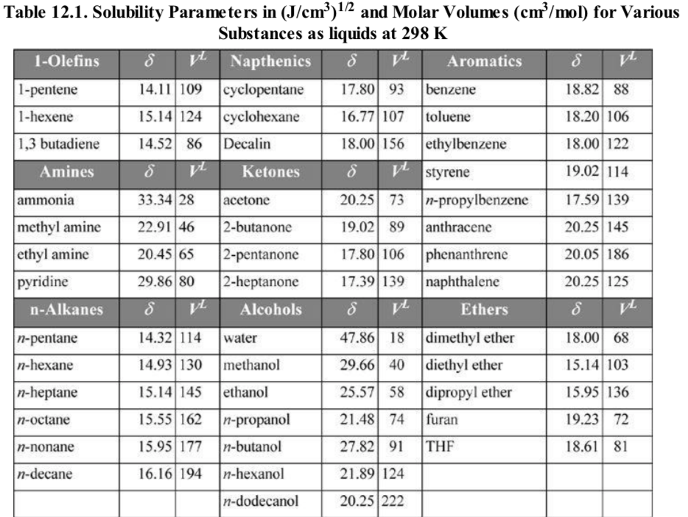

Slide 4
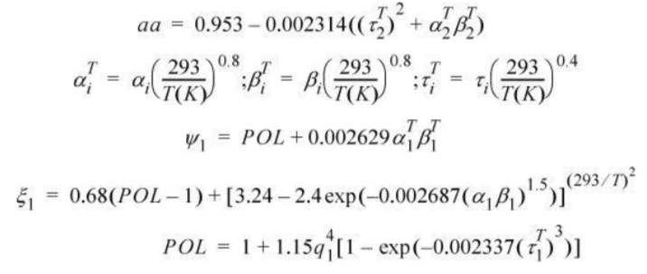

Slide 5
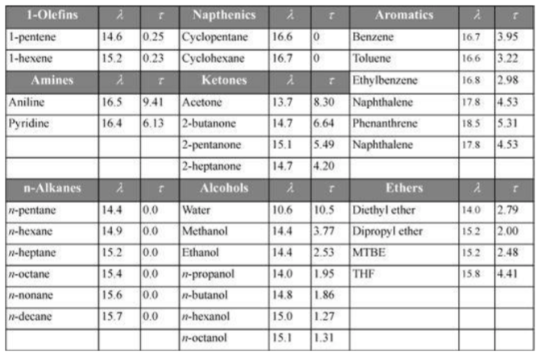

Slide 6
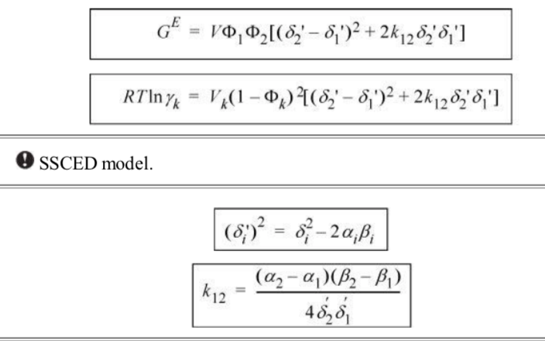

Slide 7
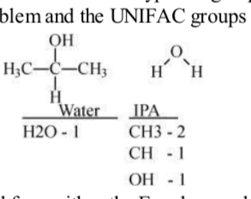
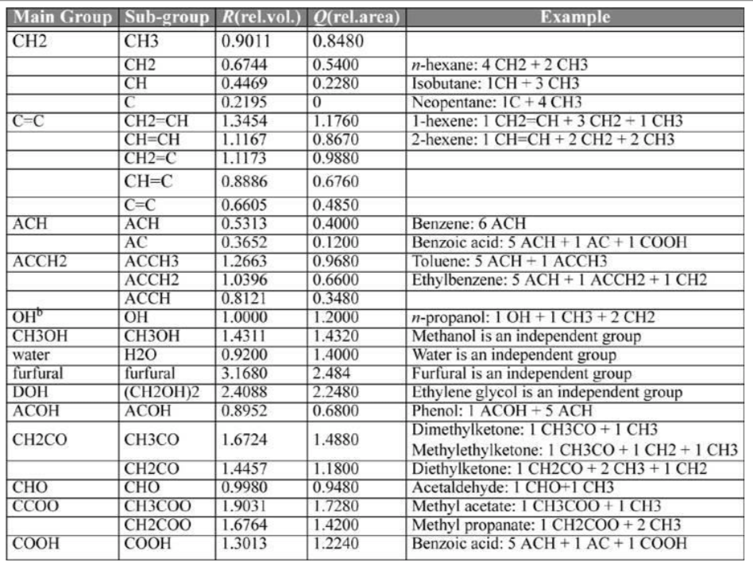

Slide 8
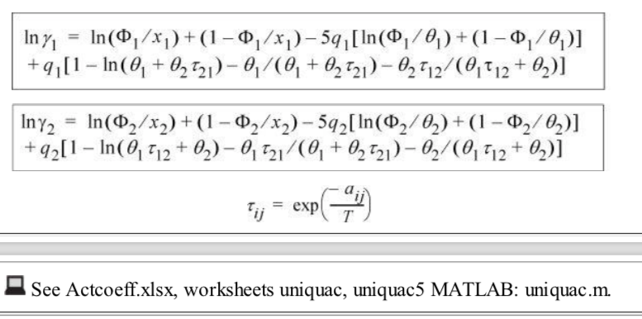

Slide 9
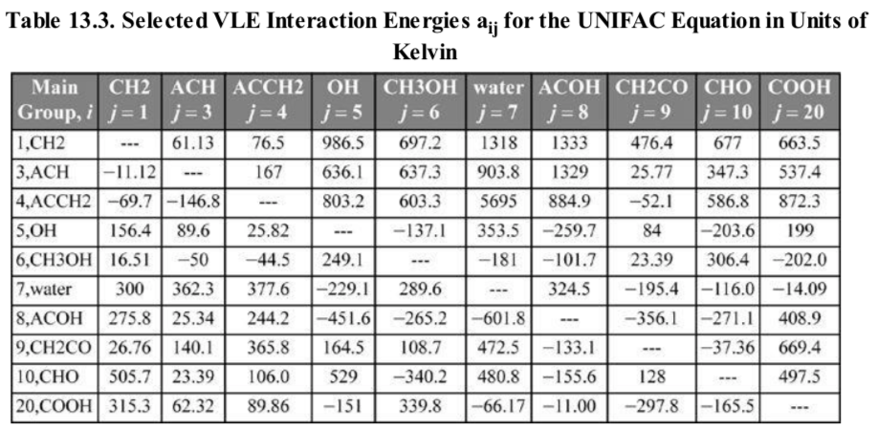

Slide 10
Important to stripping, liquid extraction, precipitation and other separation processes.

Slide 12
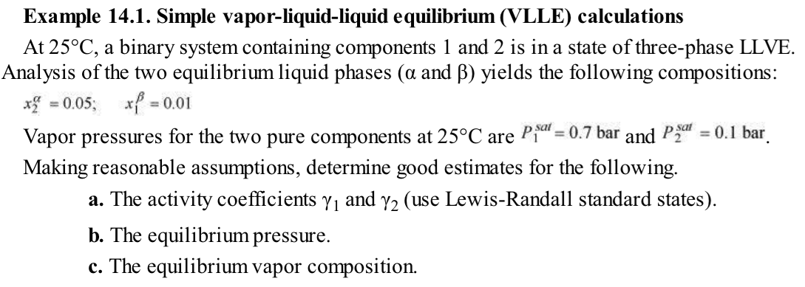

Slide 14
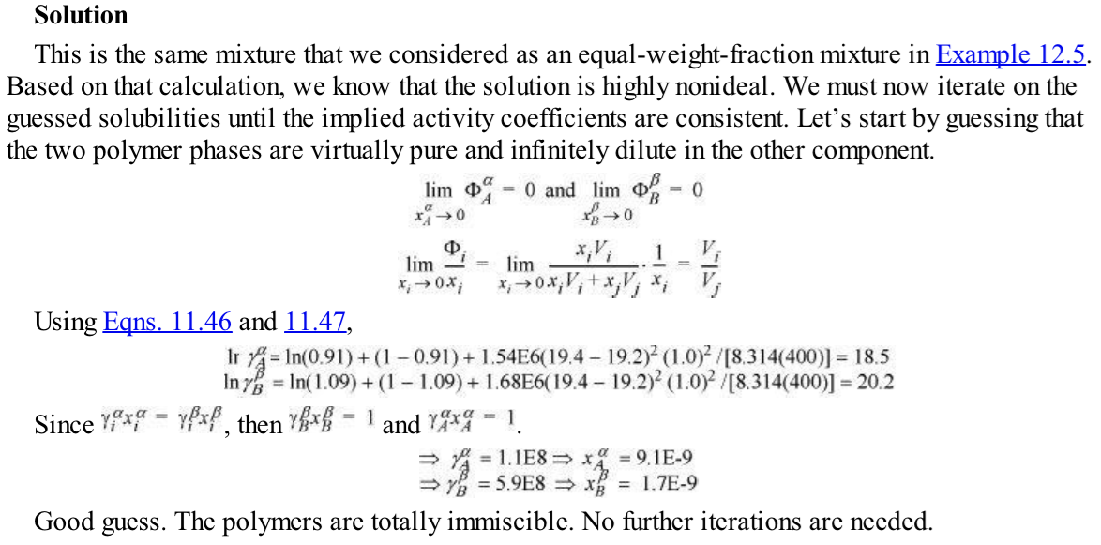
Calculate gamma
using 12.36
And zero limit
For pure x = 1 y=1 so Py = x Psat gamma
P = Psat and gamma is 1 for pure
So (x gamma) for matching phase with
pure is 1 so get x then use x and 12.36
To get gamma, then get x from 1/gamma

Slide 16
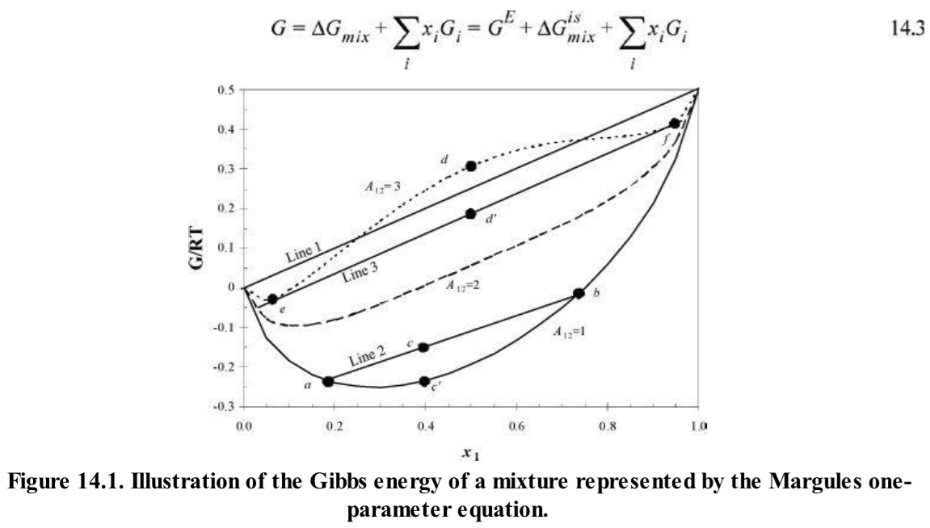

Slide 17
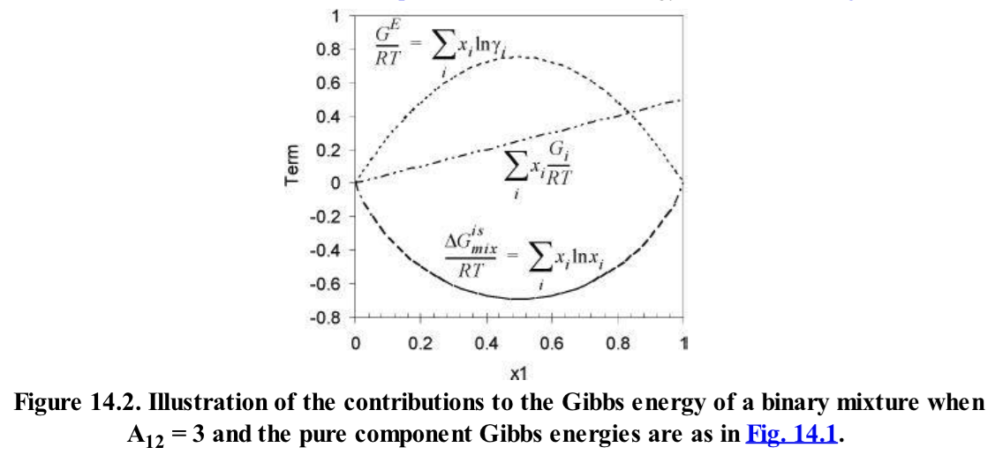

Slide 18
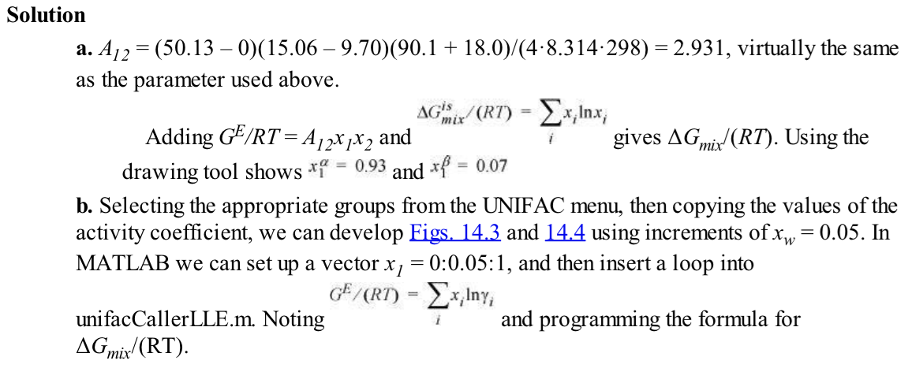

Slide 19
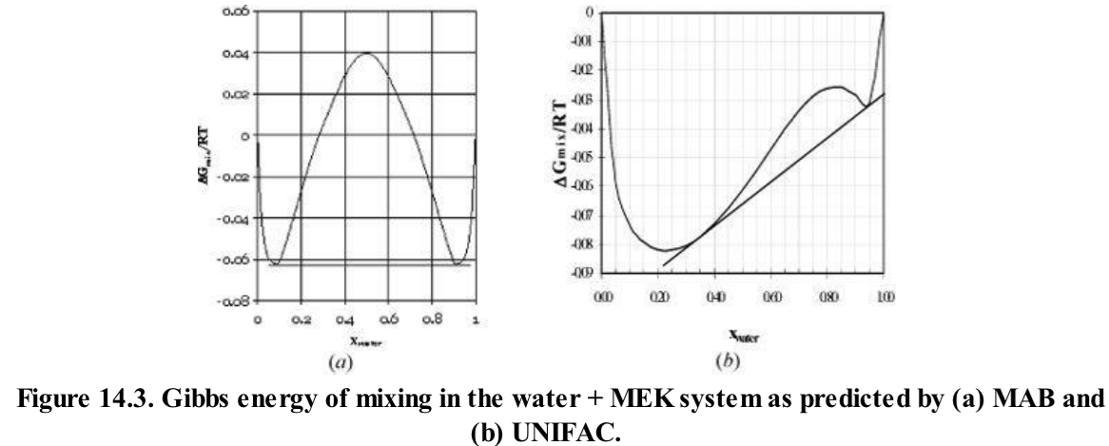

Slide 20
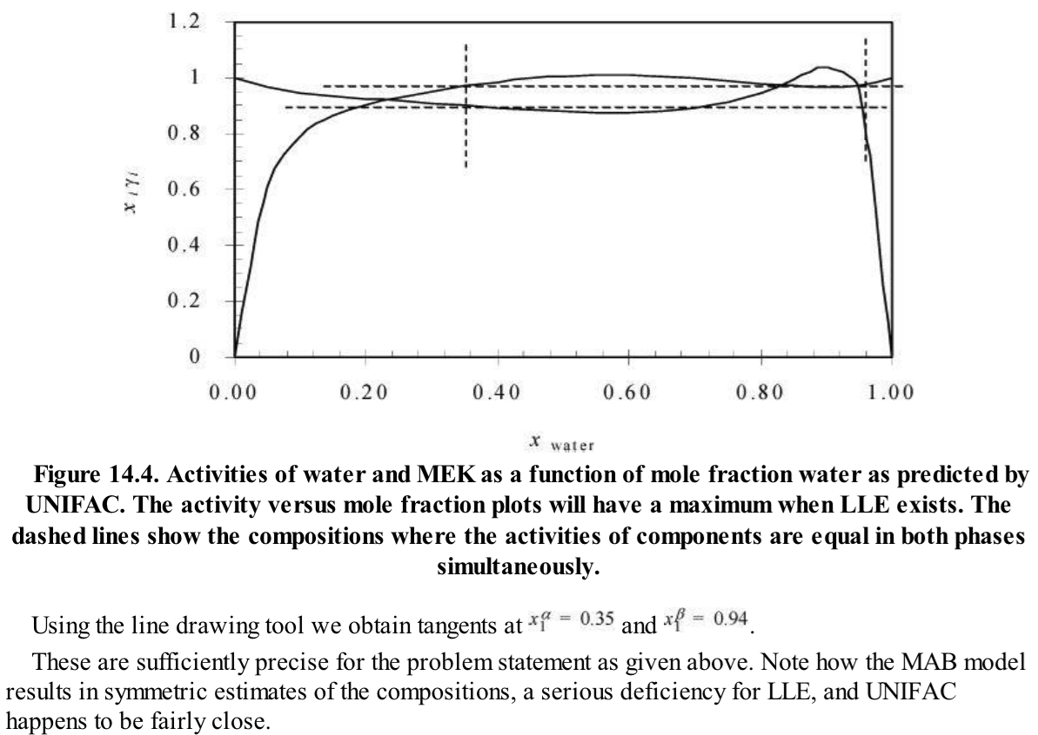

Slide 21
Activity a_{i}^{α}=a_{i}^{β}

Slide 22
Activity a_{i}^{α}=a_{i}^{β}
For ternary x₃ given

Slide 23
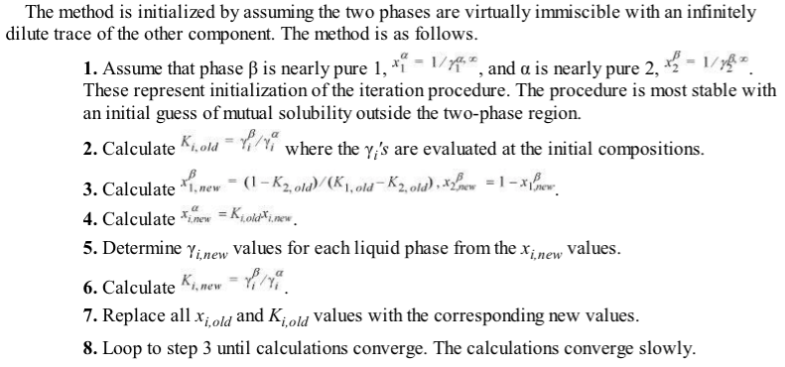
USE UNIFAC, MAB, SSCED etc.
USE UNIFAC, MAB, SSCED etc.

Slide 24
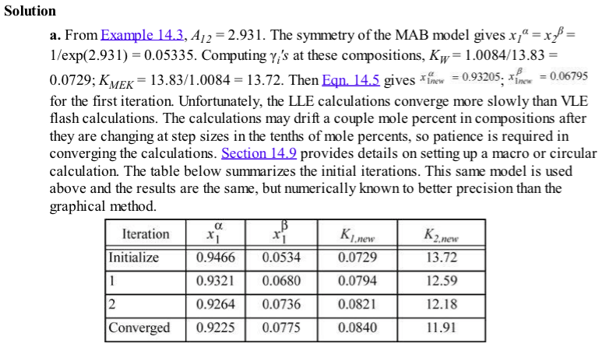

Slide 27
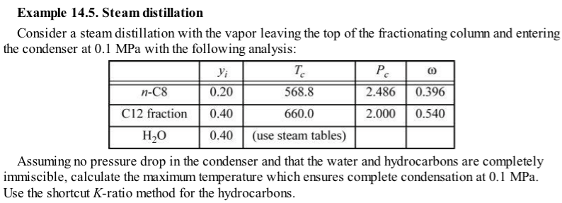

Slide 28
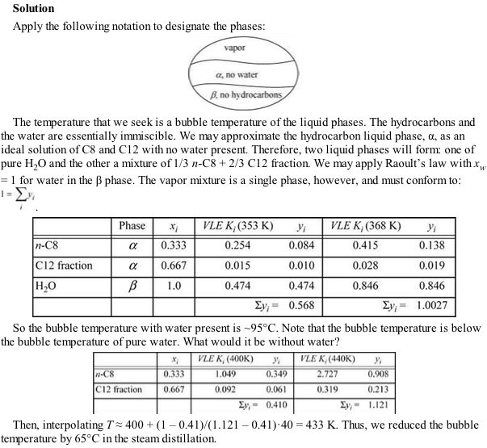

Slide 29
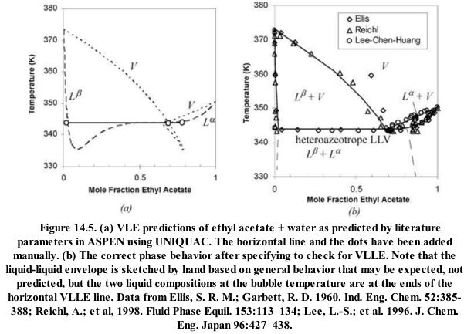
F =1 = line
F = 0 = point
F = 2 = space
Gibbs phase rule F = C – P +2

Slide 30
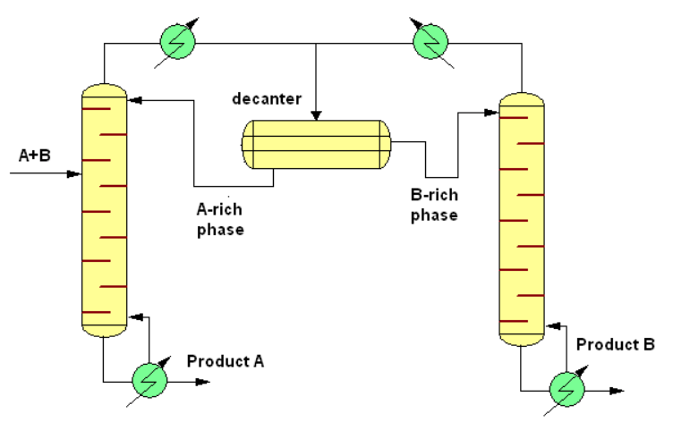
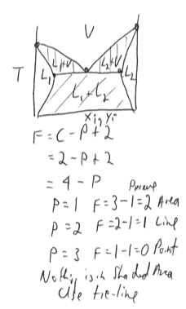
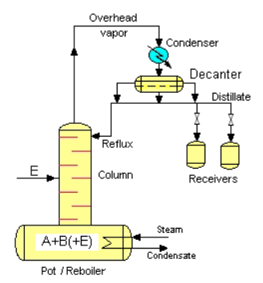
Continuous
Batch

Slide 31
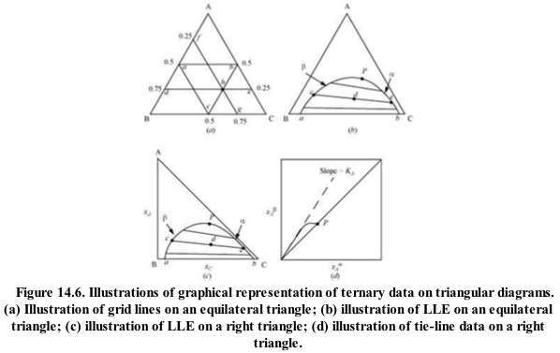
Each plot is for a fixed T and P

Slide 32
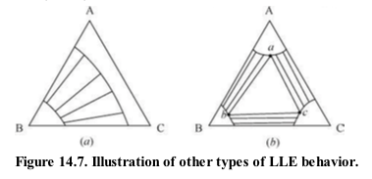

Slide 33
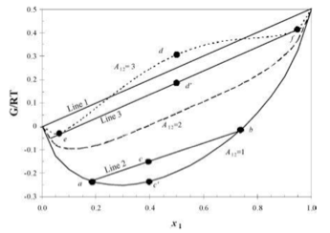
A₁₂ = a + b/T

Slide 36
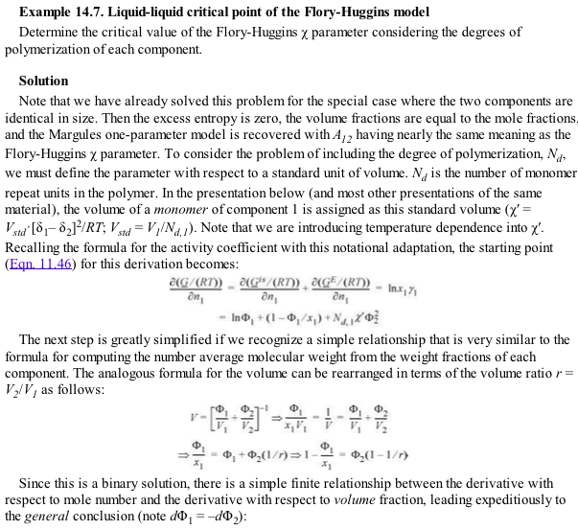

Slide 37
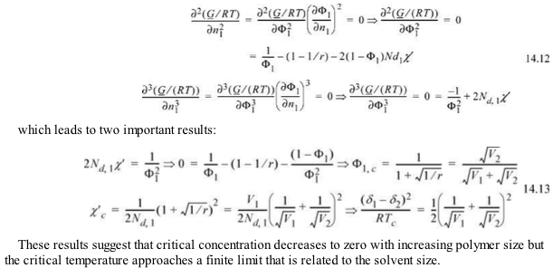
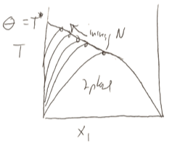

Slide 38
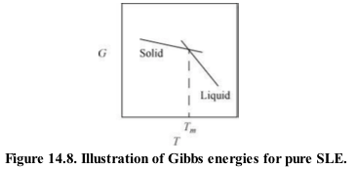

Slide 39
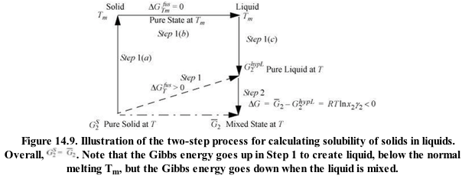

Slide 40
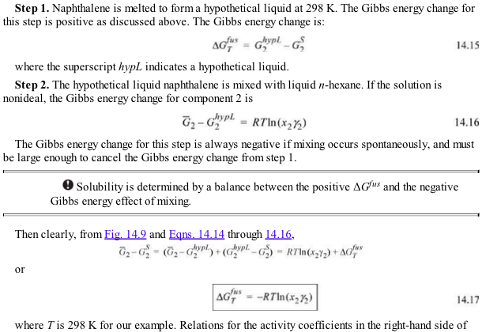

Slide 42
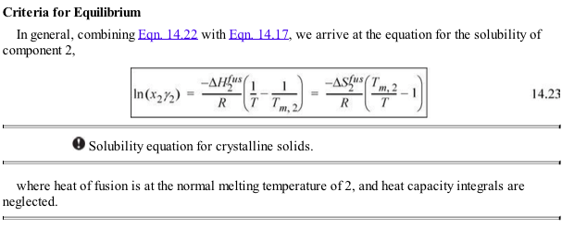

Slide 43
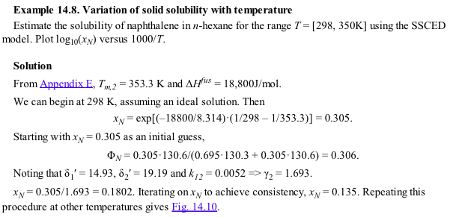
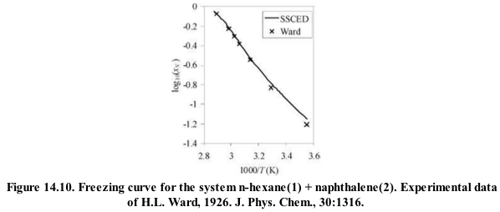
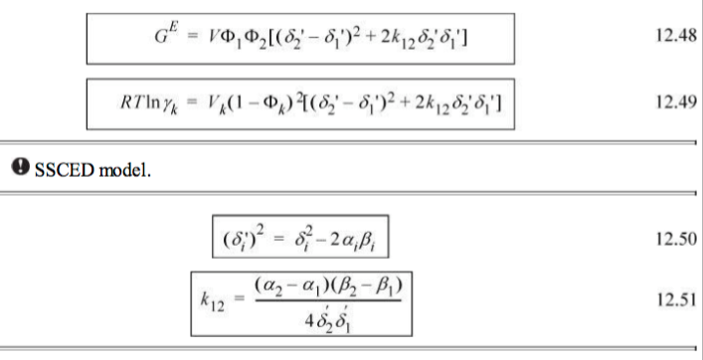
SSCED p. 482

Slide 44
Ice/salt melting point depression

Slide 45
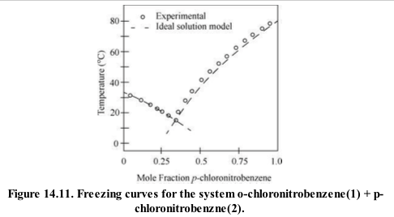

Slide 46
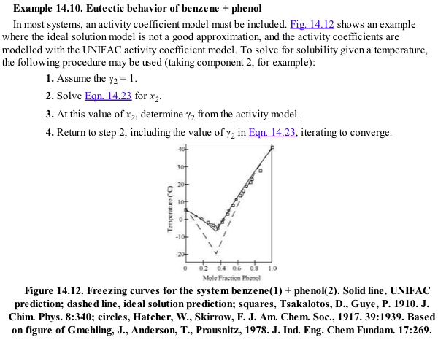
UNIFAC .xls

Slide 47
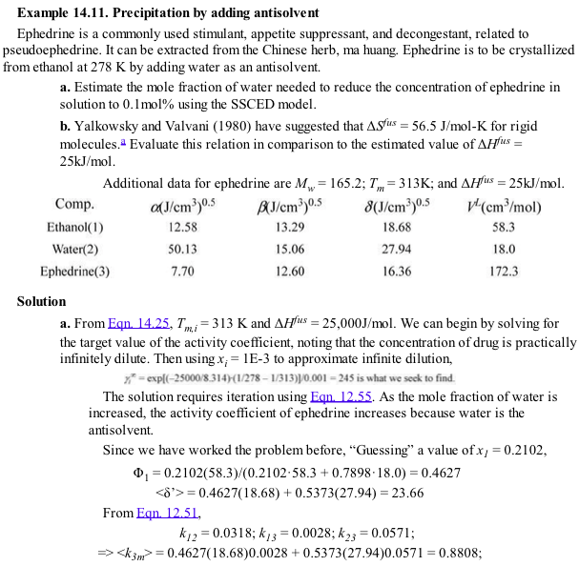

Slide 48
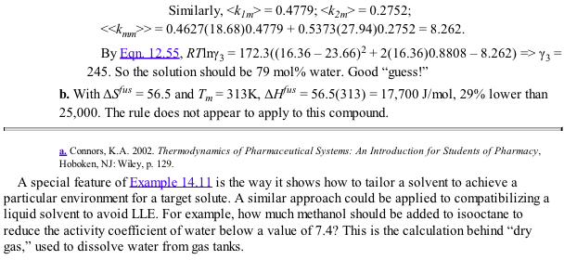

Slide 49
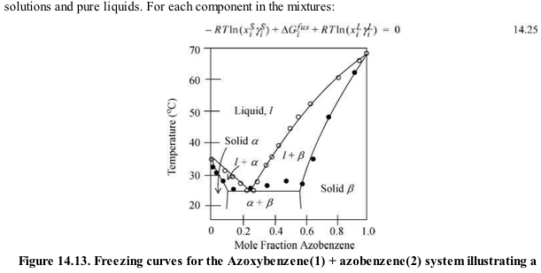

Slide 50
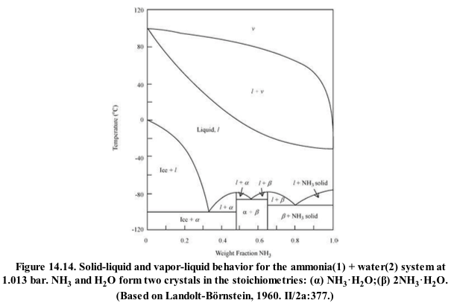

Slide 53
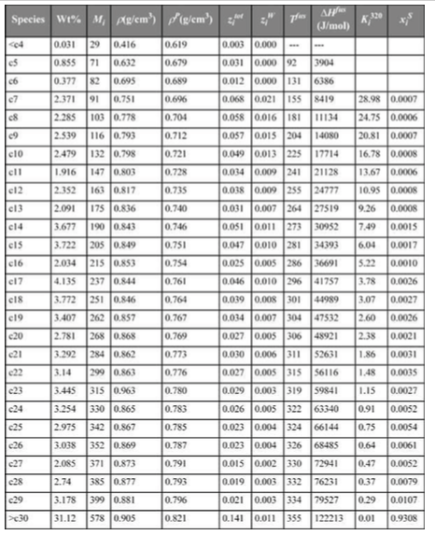

Slide 55
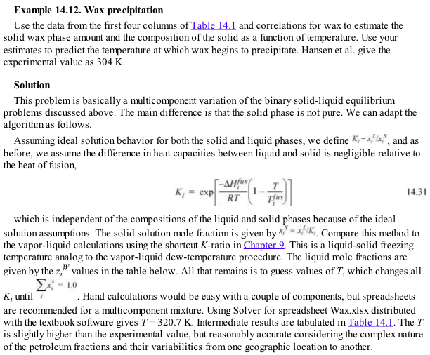
See Wax.xlsx

Slide 57
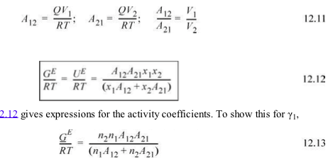
pp 14.3
a’s are Van der Waals constants

Slide 59
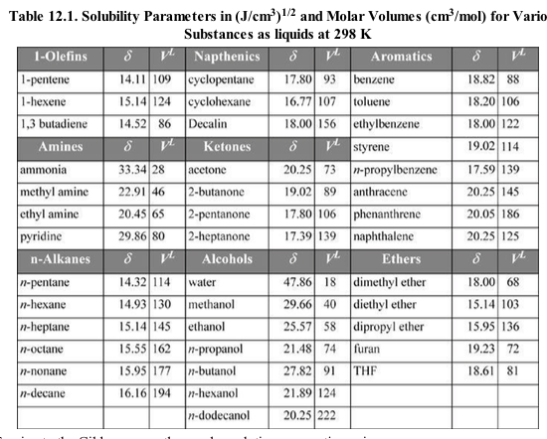

Slide 60
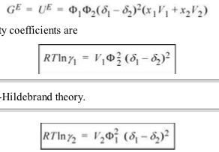

Slide 62
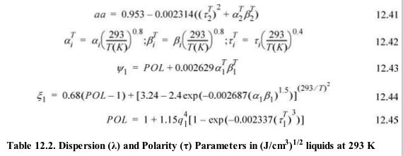

Slide 63
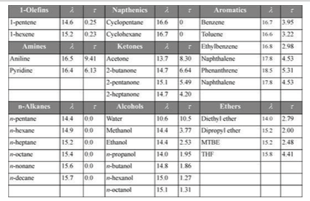

Slide 66
